Slide 1
State of
Social Mission Alliance
January 19, 4pm EST

Slide 2
Welcome & Introduction
Toyese Oyeyemi Jr., MPH, MCHES
Executive Director

Slide 3
3

Slide 4
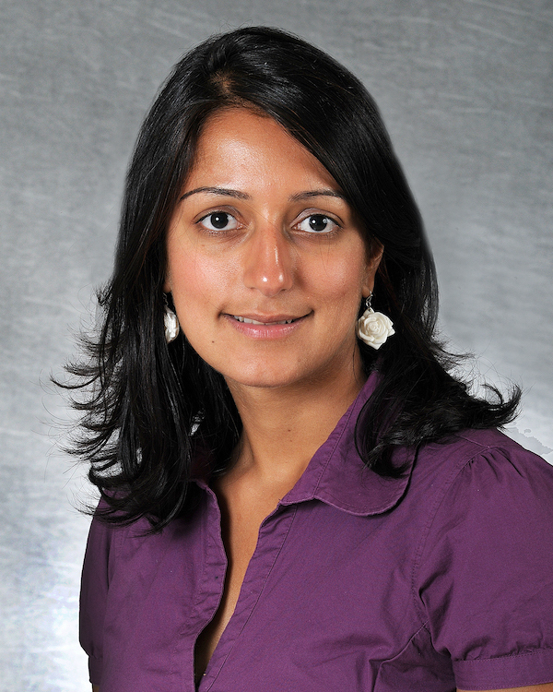
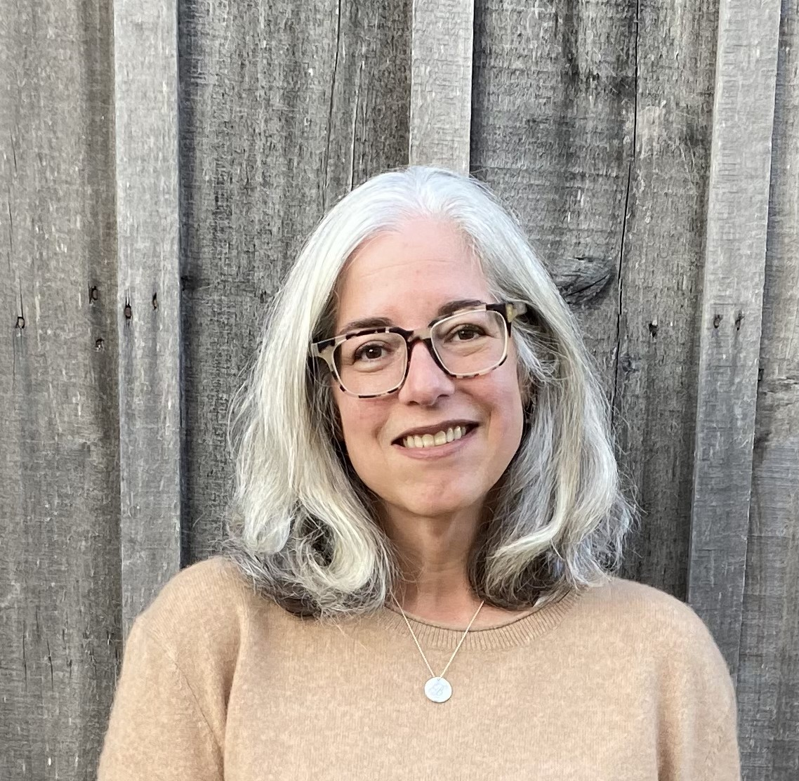
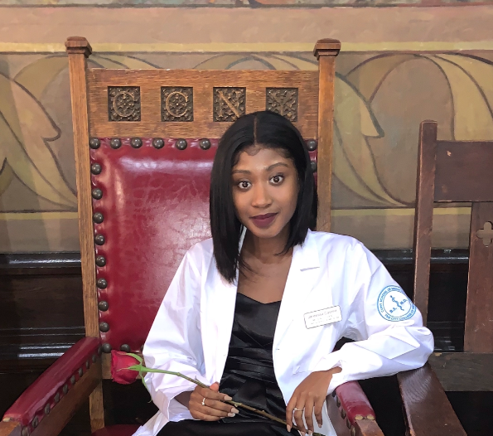
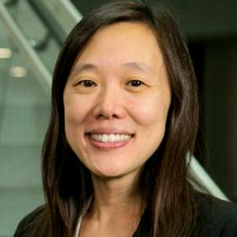
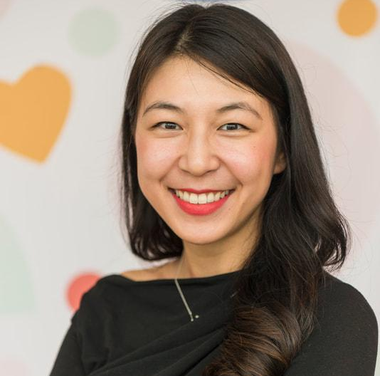
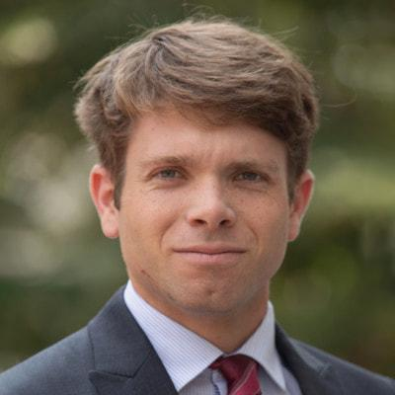
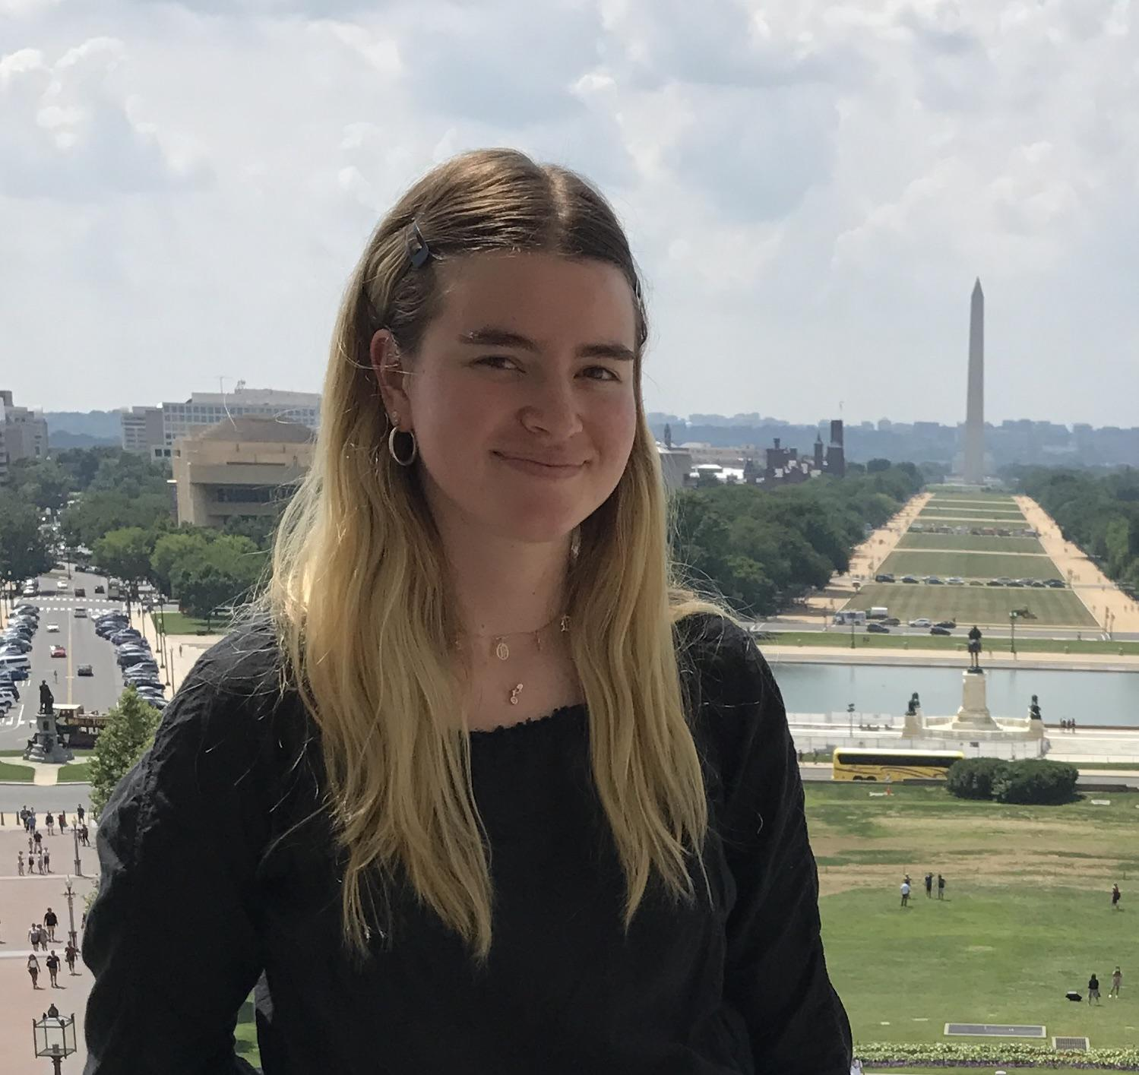
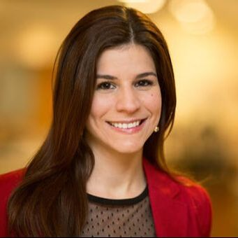
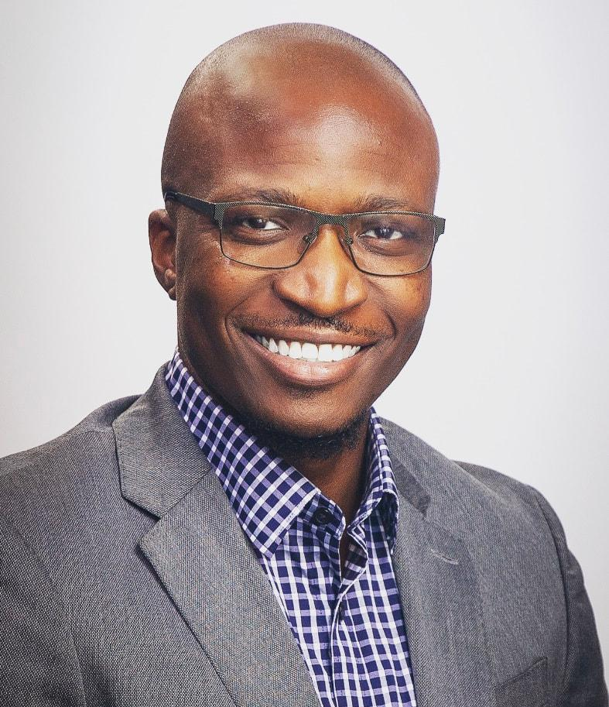
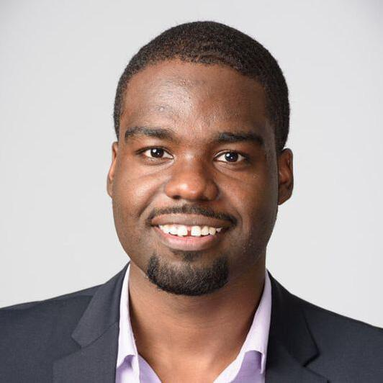
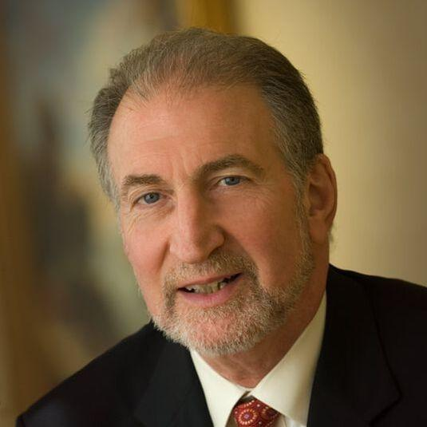
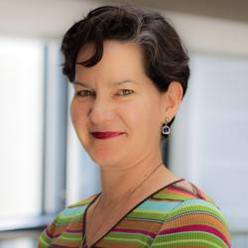
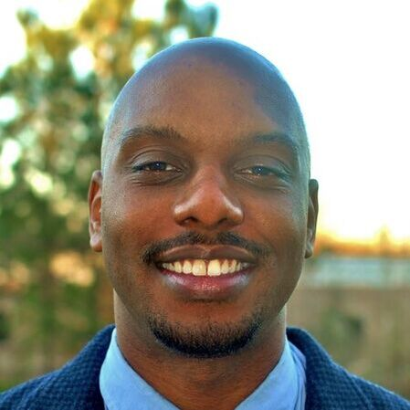
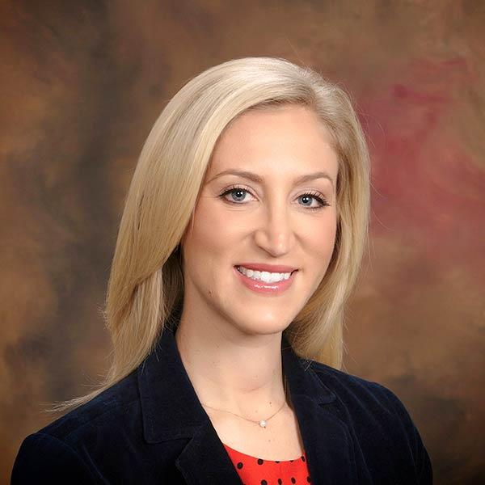
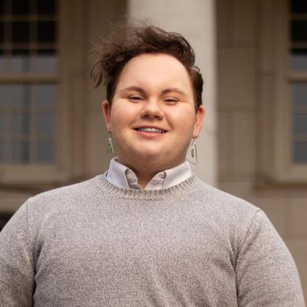
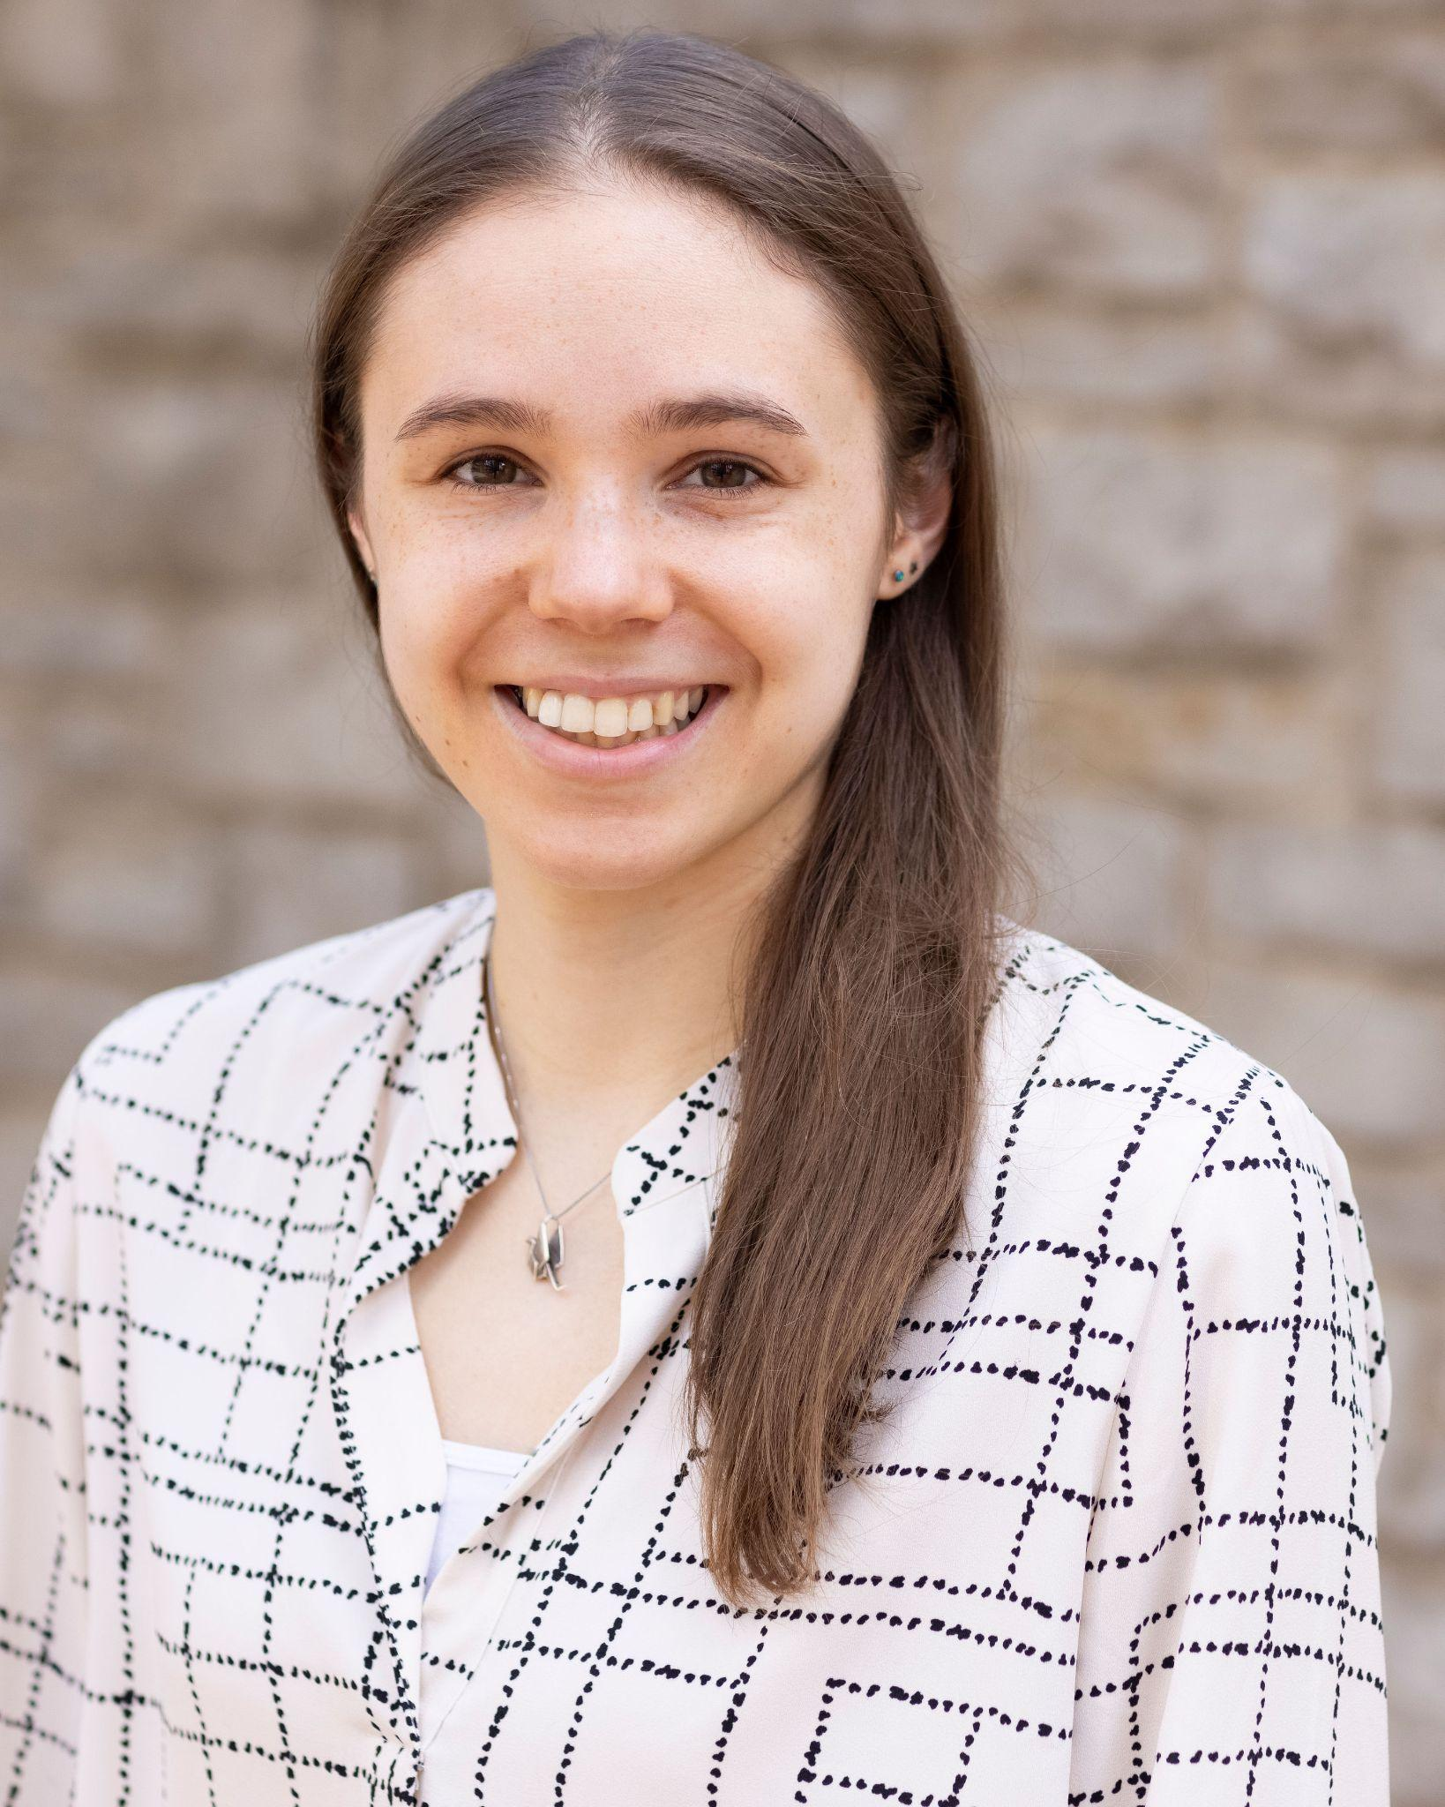
SMA Team
Sonal Batra
Leigh Anne Butler
Jaileessa Casimir
Candice Chen
Isabel Chen
Finn Dobkin
Samantha Hardy
Maria Martinez
Toyese Oyeyemi
Robert Rock
Edward Salsberg
Moira Secrest
Jamar Slocum
Natalie Kirilichin
Florence Tyler
Katie Webster

Slide 5
Social Mission Alliance
Programs & Initiatives
Research → Advocacy

Slide 7
Social Mission Research
Meg Ziemann, Research Scientist at the
Fitzhugh Mullan Institute for Health Workforce Equity

Slide 8
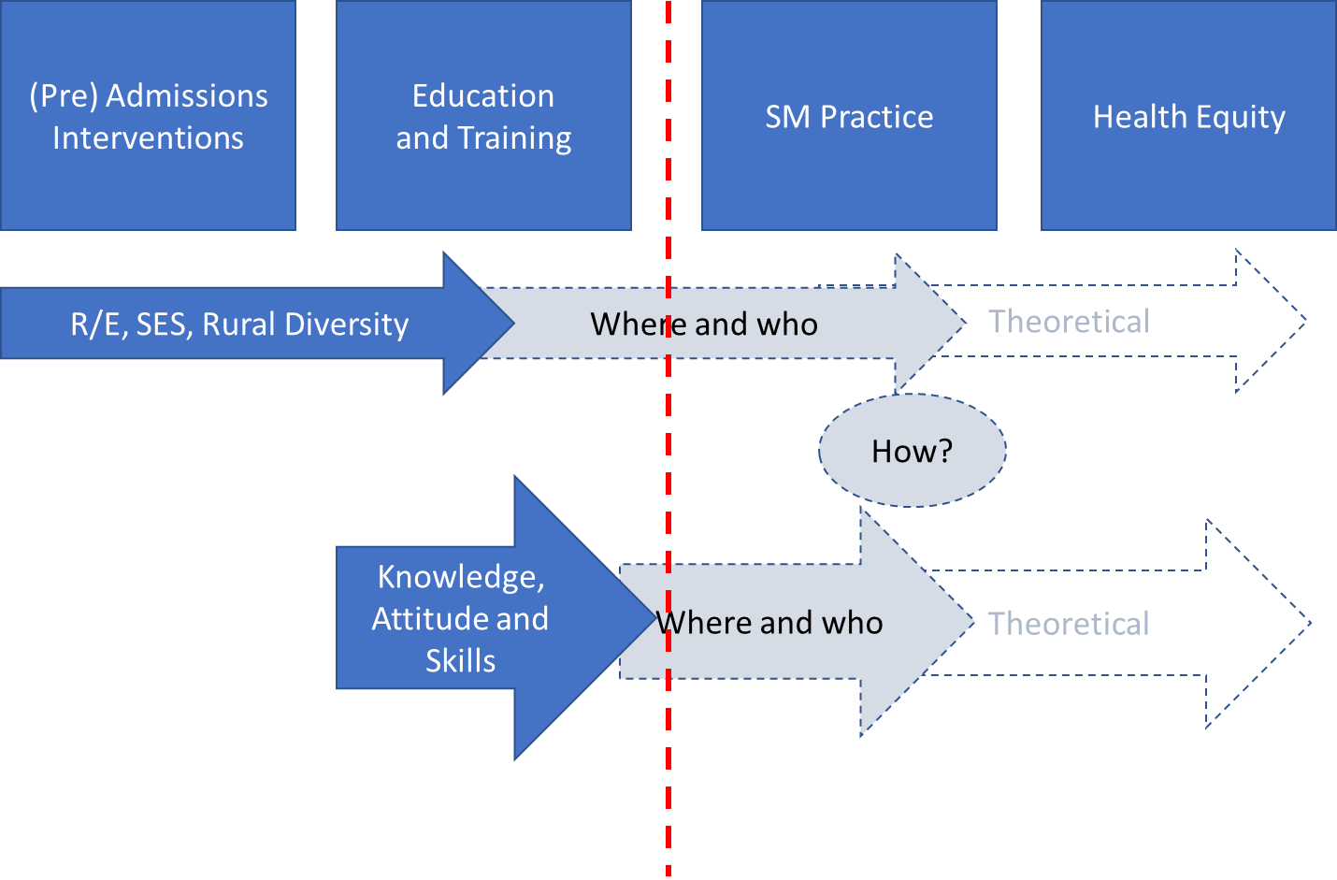

Slide 9
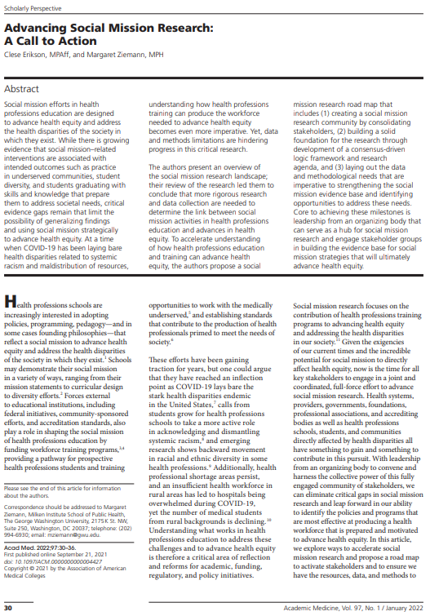

Slide 10
Research Advisory Committee
Committee Aim: To advance social mission research by organizing the research community and engaging key stakeholders in social mission research activities
Currently 15 members (researchers, practitioners, students) representing 7 institutions and multiple disciplines (nursing, medicine, public health, anthropology, health services research, and more…)
Current and Planned Activities:
Social Mission Theory of Change
Social Mission Research Agenda
Convenings
Mentorship
highlight and share faculty, resident, and student research
Ways to get involved:
Share your social mission research or research ideas
JOIN the committee!
Email Meg: mgpickel@gmail.com

Slide 11
Conferences
Jamar Slocum, MD, MBA, MPH

Slide 12
Opportunities to get involved with the Spring 2024 Conference, contact:
info@socialmission.org

Slide 13
Advocacy Advisory Council
Robert Rock, MD

Slide 14
Advocacy Advisory Council
Strategic Goal: leverage the extensive research expertise and professional relationships for advocacy in the area of social mission
Advocacy Goals:
Diversifying the healthcare workforce
Infusing social mission in health professional training accreditation criteria

Slide 15
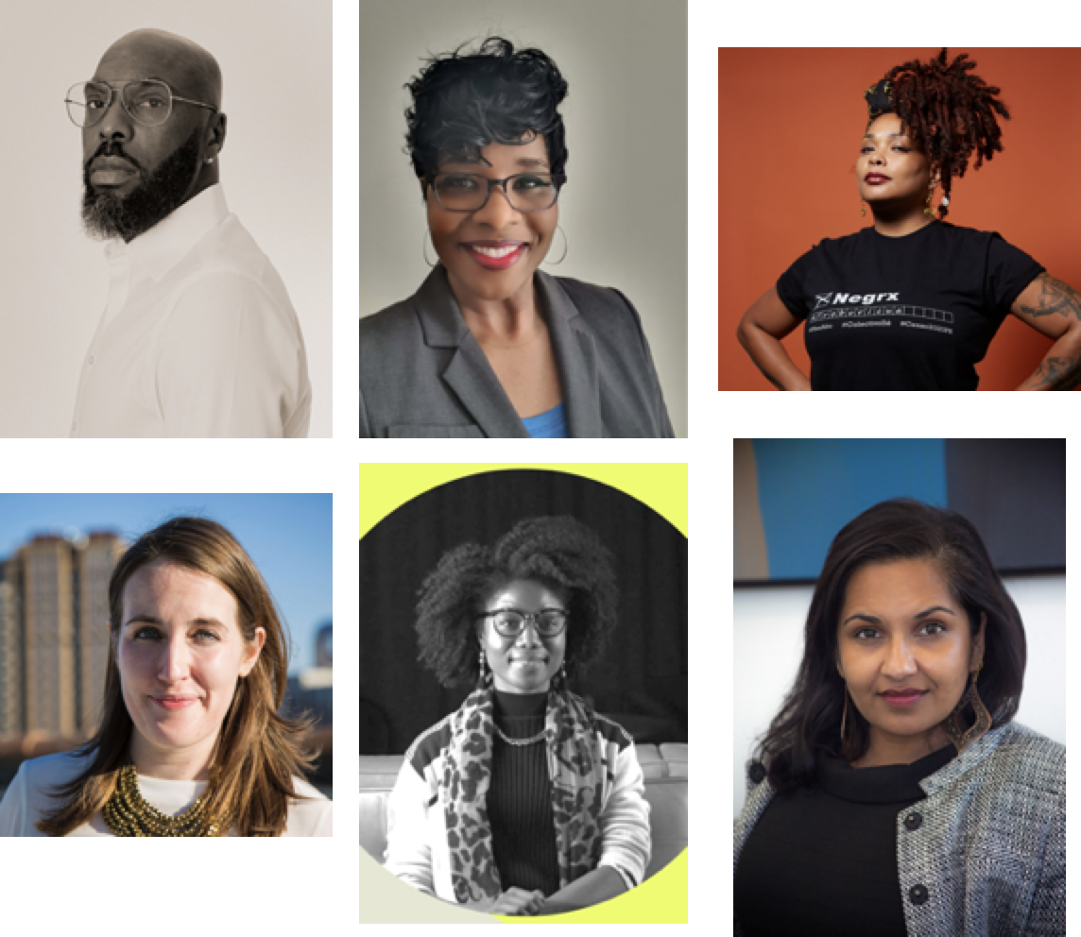
Advocacy Advisory Council
The Advocacy Advisory Committee: a group assembled to guide SMA in the first steps of achieving this strategic goal
To put our best foot forward not only with formulating our advocacy platform, but establishing a blueprint of how to do with work in a way that is equitable and inclusive.

Slide 16
Advocacy Advisory Council
Exploring how to engage with non-traditional partners in forming advocacy coalitions around these issues
Developing media strategies that translate research into impactful messages that reach the widest audience
Highlighting the work of groups advancing health equity as a means to tangibly display what social mission looks like

Slide 17
Advocacy Advisory Council
If interested in taking part of advocacy efforts with SMA, please reach out to Robert Rock and Raashmi Krishnasamy at info@socialmission.org
Include “Advocacy Advisory Council” in the subject line.
Structured opportunities to get involved will be forthcoming

Slide 18
SCOTUS Decision & Role of SMA
Edward Salsberg, MPA

Slide 19
SCOTUS Call for Action

Slide 20
Preparing for and Responding to the Supreme Court Decision on Affirmative Action
“If Affirmative Action Ends, College Admissions May Be Changed Forever” New York Times 1/15/23
What are SMA members doing to prepare?
What can the SMA do to prepare and respond?
What are alternatives to affirmative action to increase diversity to reflect the population?
SMA is establishing an ad hoc committee to explore potential actions.
JOIN US! Contact: esalsberg@gwu.edu
SMA members are critical players!

Slide 21
Thank You!
Join our movement:
www.socialmission.org
Find us on Twitter and LinkedIn

